Slide 1
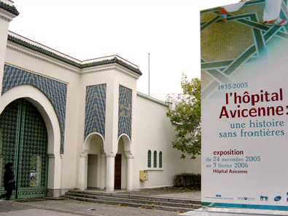
Lenalidomide Combined to AZA in Higher Risk MDS with Del 5q A Study by the Groupe Francophone Des Myelodysplasies (GFM)
Lionel Adès

Slide 2
Lenalidomide in MDS
Has become the « gold standard » in low and int 1 MDS with del 5q
Also appears to play a role in:
Int 2 and high risk MDS with del 5q

Slide 3
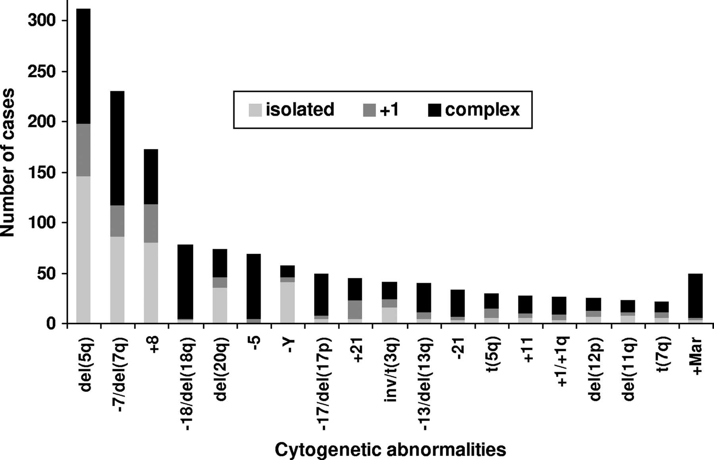
Frequency of cytogenetic abnormalities in MDS
Karyotype abnormalities involving deletions of 5q are the most frequent, occurring in 30% of the patients with clonal cytogenetic abnormalities (15% of the patients with successful cytogenetic analyses).
Is associated with 1 or more cytogenetic abnormalities in more thant 50% of the cases.
Haase, D. et al. Blood 2007

Slide 4
Survival of del5q with and without additional abnormalities
Haase, D. et al. Blood 2007

Slide 5
Phase II study of Lenalidomide in 45 high risk pts with del5q
Adès et al. Blood 2009

Slide 6
Outcome
Thirteen of the 47 patients (27%) achieved response according to IWG 2006 criteria, including 7 (15%) CR, 2 marrow CR, and 4 erythroid hematologic improvement.
RBC transfusion independence was achieved in 12 patients (25%), including the 7 CR, one of the marrow CR, and the 4 HI-E
Adès et al. Blood 2009

Slide 7
Prognostic factor for CR
Adès et al. Blood 2009

Slide 8
Overall Survival
Adès et al. Blood 2009

Slide 9
How to improve outcome?
Role of High dose Chemotherapy ?
Role of Hypomethylating agents ?
Combination therapy?

Slide 10
Len Combined to Intensive CT In AML and Higher Risk MDS with Del 5q Treatment Schedule
Induction Course
monthly consolidations x6
monthly Maintenance
1st Cohort
DNR 45 mg/m2 x3
ARAC 200 mg/m2x7
Lenalidomide 10 mg x 21
DNR 45 mg/m2 x1
ARAC 60 mg/m2x 10
Lenalidomide 10 mg x 14
Lenalidomide 10 mg x 14
DNR 60 mg/m2 x3
ARAC 200 mg/m2x7
Lenalidomide 10 mg x 21
DNR 60 mg/m2 x1
ARAC 60 mg/m2x 10
Lenalidomide 10 mg x 14
2nd Cohort
Lenalidomide 10 mg x 14

Slide 11
Patients
 | Value | %
N | 63 | -
Age >60 years >70 years | 66 years (30–79) 43 24 | - 68% 38%
Male | 34 | 54%
AML (ie >20% blasts) 20-30% blasts > 30 % blasts | 48 16 32 | 76% 25% 51%
RAEB-2 | 15 | 24%
Isolated del 5q | 4 | 6%
Del 5q + 1 abn | 8 | 13%
Complex Karyotype | 51 | 81%
WBC (G/l) | 2.85 G/l (0.6-100) | -
Hemoglobin (g/dl) | 8.7 g/dl (5.6-12.1) | -
Platelet (G/l) | 44.5 G/l (11-260) | -
Cohort 1 (DNR 45) | 32 | 50%
Cohort 2 (DNR 60) | 31 | 50%

Slide 12
Response
 | value | %
Early Death | 7 | 11%
Complete Remission | 31 | 49%
CR incomple plt Recov. | 1 | 2%
mCR | 3 | 5%
Partial Remission | 5 | 8%
ORR 63%

Slide 13
AZA in patients with del5q – AZA001
AZA showed a median OS time of 24.4 months vs 15 months with CCR (p<10⁻³)
However, in this trial, median survival of the patients with del(5q) was only 11 months in the AZA arm versus 8 in the conventional treatment arm.
1.0
0.9
0.8
0.7
0.6
Proportion Surviving
0.5
0.4
0.3
AZA
0.2
CCR
0.1
0.0
0
5
10
15
20
25
30
35
40
Time (months) from Randomization
Fenaux et al, Lancet Oncol 2009

Slide 14
AZA in patients with del5q
Role of Hypomethylating agents
225 pts treated with AZA
47 with del5q (83% had a complex caryotype)
Median OS was 8.9 mo in del5q vs 15.3 in non del5q (p=0.002)
Itzykson et al. ASH 2008

Slide 15
AZA in combination with Lenalidomide
19 pts with higher-risk MDS using a "3+3" dose escalation design
Cohort | AZA | Lenalidomide | Patients | Grade 3/4 non-heme toxicities | Best response
1 | 75 mg/m2 SC days 1-5 | 5 mg PO days 1-14 | 1 Int-1 2 Int-2 | 1 | 2 CR 1 progression
2 | 75 mg/m2 SC days 1-5 | 5 mg PO days 1-21 | 2 Int-2 1 High | 2 | 1 CR 1 PR 1 HI
3 | 75 mg/m2 SC days 1-5 | 10 mg PO days 1-21 | 1 Int-2 2 High | 0 | 2 CR 1 stable disease
4 | 50 mg/m2 SC days 1-5, 8-12 | 5 mg PO days 1-14 | 1 Int-1 2 Int-2 | 2 | 2 CR 1 stable disease
5 | 50 mg/m2 SC days 1-5, 8-12 | 5 mg PO days 1-21 | 2 Int-2 1 High | 2 | 1 HI 1 stable disease 1 progression
9 | 50 mg/m2 SC days 1-5, 8-12 | 10 mg PO days 1-21 | 1 Int-1 1 Int-2 1 High | 2 | 1 HI 1 BM CR 1 not yet evaluable
Of the 17 pts evaluable for response, the overall response rate was 71%
No DLTs in any cohort
Sekeres et al. ASH 2008

Slide 16
Ongoing trials
A phase 2 study of the efficacy and safety of lenalidomide combined to Azacitidine in intermediate-2-or high risk MDS and AML with del 5 q31
Cycle 1
Cycle 2
Cycle 3
Cycle 4
5 AZA 75 mg/m2 x 5 days
5 AZA 50 or 75 mg/m2 x 5 days
5 AZA 50 or 75 mg/m2 x 5 days
5 AZA 50 or 75 mg/m2 x 5 days
COHORT 1
Lenalidomide 5 mg/d x 14 days
Lenalidomide 5 mg/d x 14 days
Lenalidomide 5 mg/d x 14 days
Lenalidomide 5 mg/d x 14 days
5 AZA 75 mg/m2 x 5 days
5 AZA 50 or 75 mg/m2 x 5 days
5 AZA 50 or 75 mg/m2 x 5 days
5 AZA 50 or 75 mg/m2 x 5 days
COHORT 2
Lenalidomide 5 mg/d x 21 days
Lenalidomide 5 mg/d x 21 days
Lenalidomide 5 mg/d x 21 days
Lenalidomide 5 mg/d x 21 days
5 AZA 75 mg/m2 x 5 days
5 AZA 50 or 75 mg/m2 x 5 days
5 AZA 50 or 75 mg/m2 x 5 days
5 AZA 50 or 75 mg/m2 x 5 days
COHORT 3
Lenalidomide 10 mg/d x 21 days
Lenalidomide 10 mg/d x 21 days
Lenalidomide 10 mg/d x 21 days
Lenalidomide 10 mg/d x 21 days
Adès , ongoing trial

Slide 17
Ongoing trial…
N=11
All with complex caryotype
Elderly patients ( up to 86 years)
Treatment is as expected myelotoxic
… but efficient (3 CR/11 pts after 2 cycles)

Slide 18
Finally…
AZA PLUS Trial
All pts with high risk MDS
Objective: To identify among the combination of AZA and one of 3 drugs (Valproic Acid, Lenalidomide, Idarubicine), those arms whose responses rates after 6 courses in adult high and int-2 MDS (IPSS) will be significantly higher than that of the control arm (Azacitidine alone).

Slide 19
Design of the study
5 AZACYTIDINE
75 mg/m2 x 7 jours
5 AZACYTIDINE
75 mg/m2 x 7 jours
All High RISK MDS
IPSS INT_2 or HIGH
R
VALPROIC ACID
4-6 cycles
5 AZACYTIDINE
75 mg/m2 x 7 jours
REVLIMID
5 AZACYTIDINE
75 mg/m2 x 7 jours
SAHA

